Slide 1
FLIGHT FARE PREDICTION
Prepared by : Nurfarah Izzati binti Ahmad Yusoff

Slide 2
PROJECT OVERVIEW
PROBLEM STATEMENT
OBJECTIVE
Flight ticket prices can be something hard to guess, today we might see a price, check out the price of the same flight tomorrow, and it will be a different story. On the other hand, aviation industry faces significant challenges in setting competitive and profitable flight fares.
To analyze flight fare prediction using machine learning based on historical flight data.

Slide 3
PROJECT OVERVIEW
Data Acquisition
Data cleaning & pre-processing
Separating target and variable features
Split Train/Test Data
Fitting model using
Random Forest

Slide 4
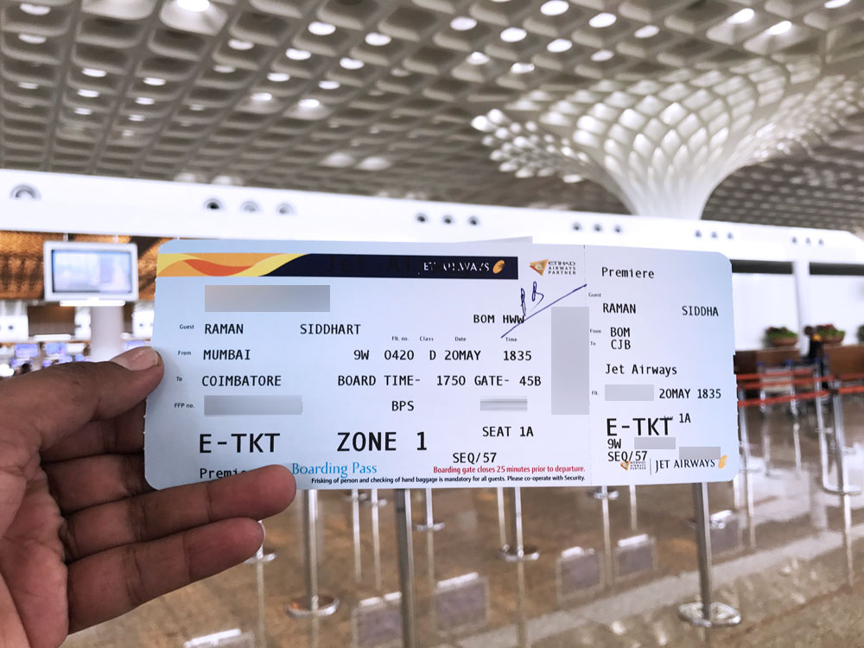
PROJECT OVERVIEW
Dataset source : Kaggle (10683, 11)
Airline
Date of Journey
Source (Depart)
Destination
Route
Departure Time
Arrival Time
Duration
Total Stop
Additional Info
Price
Flight Ticket of Jet Airways. Image source : Siddharth. Jet Airways Premiere – Boarding Pass, 2021. Accessed via : https://www.cardexpert.in/jet-airways-domestic-business-class-review/

Slide 5
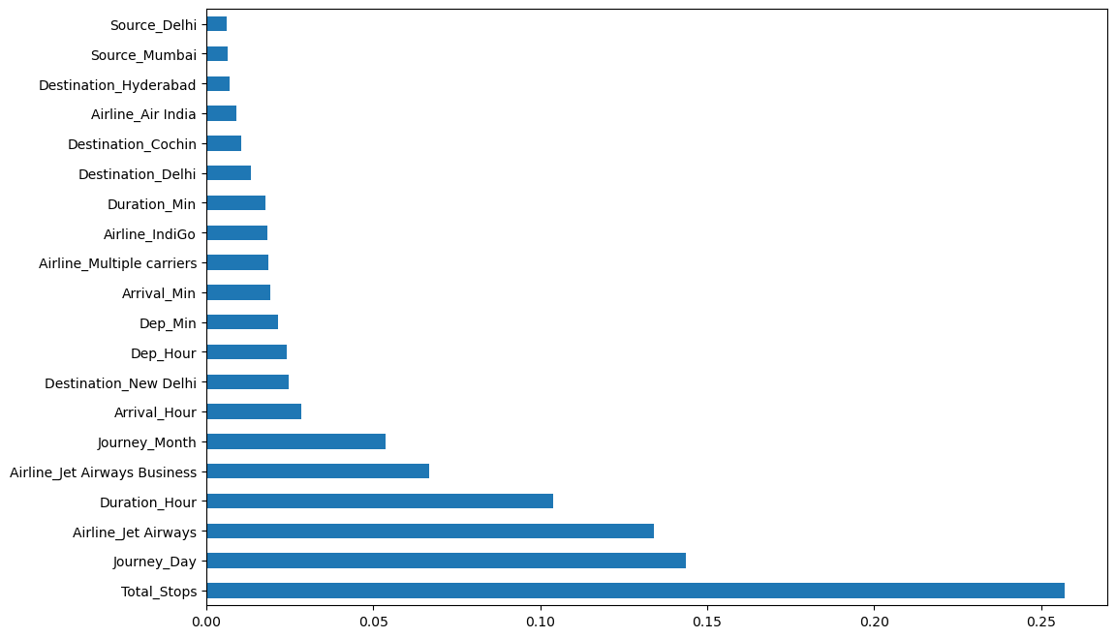
RESULTS ANALYSIS
Figure 1. Feature Importances

Slide 6
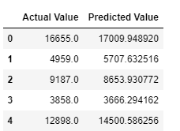
RESULTS ANALYSIS
MSE (Means Squared Error ) represents the difference between the original and predicted values extracted by squared the average difference over the data set.
Test = 4038566.893322
RMSE (Root Means Squared Error) is the error rate by the square root of MSE.
Test: 2009.6185939928998
Accuracy, R²(R squared score) describes how well the linear regression model fits the data points.
Train: 0.9525700193956842
Test: 0.7959917843766708
(95.26%, 79.60%)

Slide 7
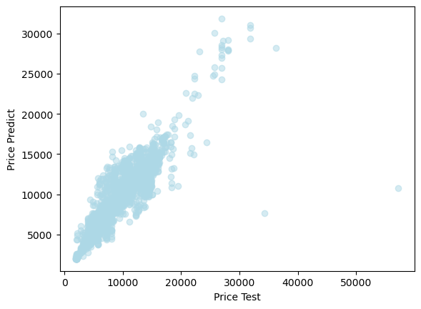
RESULTS ANALYSIS
Figure 2. Graph of Price Predict vs Price Test

Slide 8
THANK YOU

